Slide 1
ShadowFox Data Science Internship
Presented by Revanth Venkata Sai Nuthanapati

Slide 2
Introduction:
• Internship in Data Science domain.
• Worked on real-world data analysis tasks.
• Used Python and visualization libraries.

Slide 3
Beginner Level Task – Visualization Libraries:
• Created documentation for Python visualization libraries.
• Selected five libraries: Matplotlib, Seaborn, Plotly, Bokeh, and Pandas.
• Studied different types of graphs each library can generate.
• Implemented practical examples with code snippets.
• Compared features and usability of libraries.

Slide 4
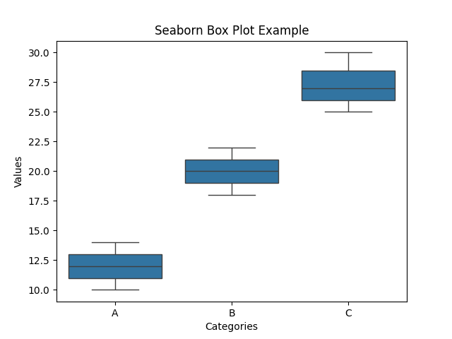
Beginner Task – Sample Visualizations:
This box plot compares the distribution of values across different categories.
Insight: Category C shows higher values, while Category A has the lowest range.

Slide 5
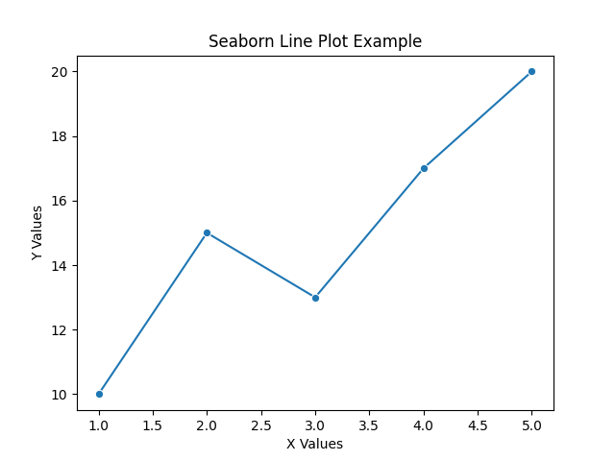
Beginner Task – Sample Visualizations:
This line plot shows the trend of Y values with respect to X values.
Insight: The overall pattern indicates an increasing trend with slight fluctuations.

Slide 6
Intermediate Task – AQI Analysis:
• Analyzed Air Quality Index data for Delhi.
• Studied pollutants such as PM2.5, PM10, and NO2.
• Performed seasonal and monthly analysis.
• Used line plots, box plots, and heatmaps.
• Derived environmental insights.

Slide 7
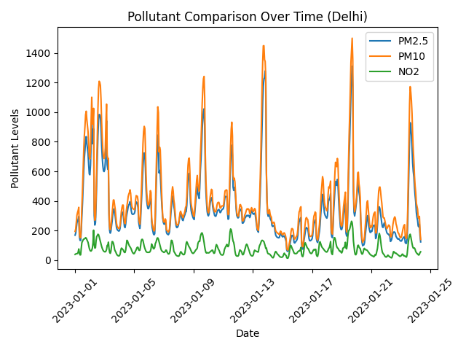
AQI Outputs:
This line plot compares the variation of PM2.5, PM10, and NO2 levels over time.
Insight: PM10 and PM2.5 show higher fluctuations, indicating they are the major contributors to air pollution.

Slide 8
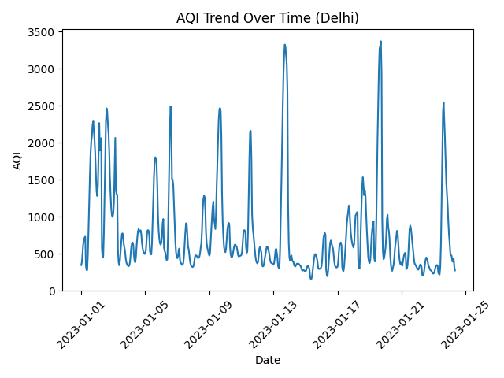
AQI Outputs:
The Air Quality Index (AQI) in Delhi shows high variability over time, with frequent spikes indicating sudden pollution surges likely due to traffic, industrial activity, or weather conditions.
Several extreme peaks (above 3000 AQI) highlight hazardous air quality events, emphasizing the need for continuous monitoring and effective pollution control measures.

Slide 9
Advanced Task – Amazon Sales Analysis:
• Explored Amazon sales dataset.
• Performed data preprocessing and feature engineering.
• Analyzed sales trends and categories.
• Created multiple visualizations.
• Derived business insights.

Slide 10
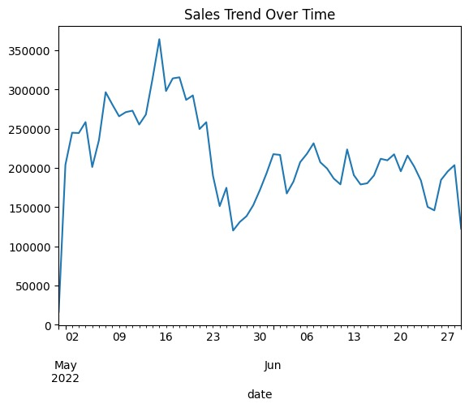
Advanced Task Outputs:
The chart shows daily sales performance over time, highlighting a strong growth in mid-May followed by a noticeable decline and fluctuations in June.
Sales peaked around mid-May, then dropped sharply and stabilized with moderate variations, indicating possible changes in demand or external factors affecting performance.

Slide 11
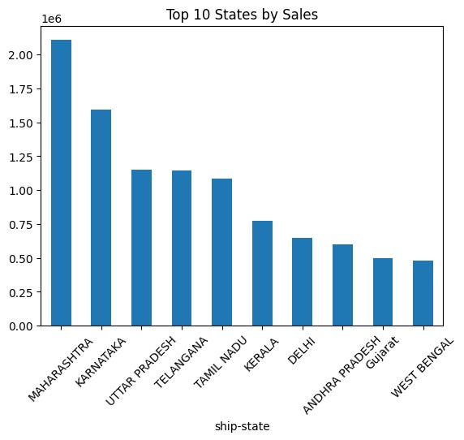
Advanced Task Outputs:
Sales Concentration: Maharashtra and Karnataka lead significantly in total sales, indicating strong market demand and business presence in these regions.
Regional Comparison: Southern and northern states like Tamil Nadu, Uttar Pradesh, and Telangana show moderate performance, while states like Gujarat and West Bengal contribute comparatively lower sales

Slide 12
Tools and Technologies:
• Python.
• Pandas.
• Matplotlib.
• Seaborn.
• Jupyter Notebook.

Slide 13
Key Learnings:
• Improved data analysis skills.
• Learned visualization techniques.
• Developed analytical thinking.
• Gained real-world project experience.

Slide 14
Conclusion:
• Successfully completed all internship tasks.
• Enhanced technical and analytical knowledge.
• Prepared for real-world data science roles.

Slide 15
Thank you.

